Slide 1
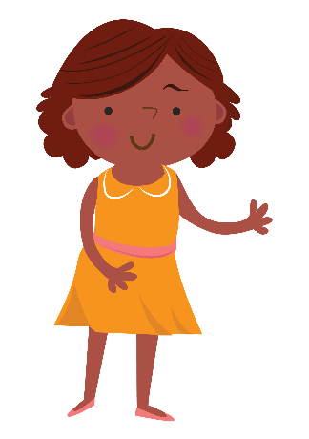
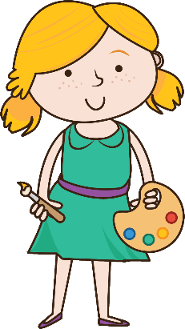
Teacher Notes
An Introduction to Aboriginal Art
A warning to all Aboriginal and Torres Strait Islander peoples:
Aboriginal and Torres Strait Islander peoples should be aware that this PowerPoint Presentation may contain images or names of people who have since passed away.

Slide 3
Symbols
I do: my turn to talk. This is the explanation section of our lesson where you are required to listen.
We do: this is where we discuss or work on the concepts together.
You do: your turn to be involved. You may be working in a group or on an activity individually.

Slide 4
An Introduction to Aboriginal Art
Photo Source: Shutterstock ID 601812083 - Ochre Hands, Red, Orange, Yellow hand prints on rock, Aboriginal art in Queensland, Australia.

Slide 5
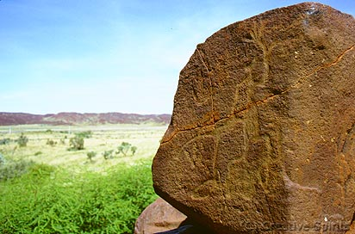
Rock Art
Rock art is the oldest surviving human art form.
In the Burrup Peninsula of Western Australia, the Aboriginal peoples of the Burrup have been creating rock art for thousands of years.
The Burrup people use rock art as a form of communication and visual imagery, establishing a deep connection with their ancestors and country.
Aboriginal petroglyph on the Burrup Peninsula.
The number of engravings are estimated to be between 500,000 and one million. Source:
https://www.creativespirits.info/australia/western-australia/karratha/murujuga-burrup-peninsula#ixzz4zrgrssjz

Slide 6
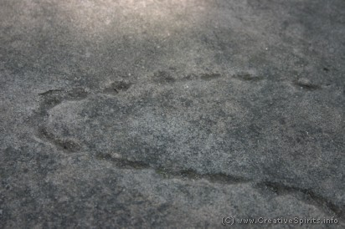
Rock Art
Some of the first forms of rock art were carvings, known as petroglyphs.
These carvings were made through the abrasion of rock surfaces using hard objects.
Holes were pegged along an outline then connected together to create an image.
Examples of this form of rock art can be found around Balls Head in Sydney, New South Wales.
Holes pegged into rock at an Aboriginal rock art site. (Balls Head, Sydney) Source:
https://www.creativespirits.info/aboriginalculture/arts/aboriginal-rock-art#ixzz4zrhYRkMc

Slide 7
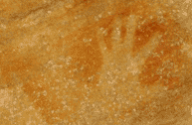
Rock Art
Another form of rock art is rock painting.
Aboriginal rock paintings can be found in the Northern Territory within the Kakadu National Park. Large rock walls and caves in this area are covered with rock paintings dating back thousands of years.
These rock paintings were made from extracted colours of earthen minerals which were then stencilled, brushed or blown onto the surface of the rock.
Aboriginal hand stencils on a rock. Source:
https://www.creativespirits.info/aboriginalculture/arts/aboriginal-rock-art#ixzz4zrhYRkMc

Slide 8
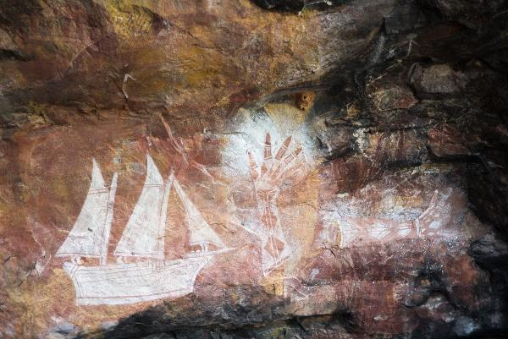
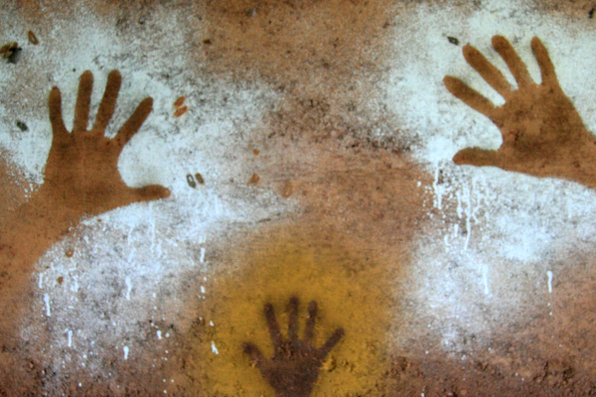
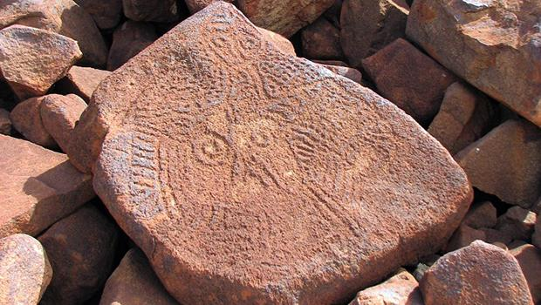
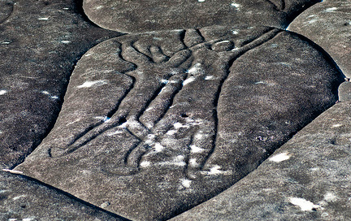
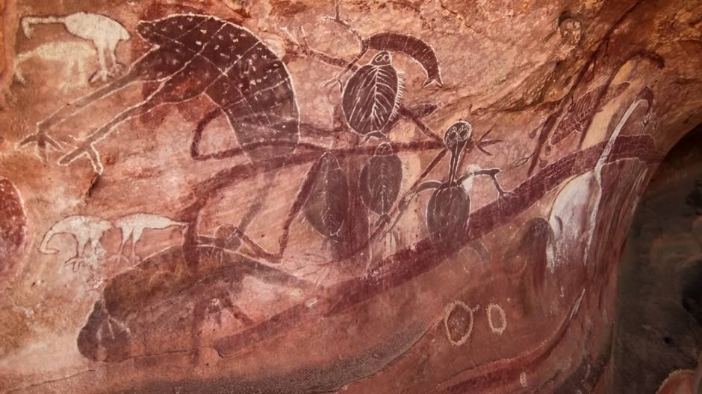
Examples of Rock Art
The images below are examples of Aboriginal rock art found in Australia.
Arnhem Land, Northern Territory.
Kakadu National Park, Northern Territory.
Burrup Peninsula, Western Australia.
Ku-ring-gai National Park, New South Wales.
Cape York Peninsula, Queensland.

Slide 9
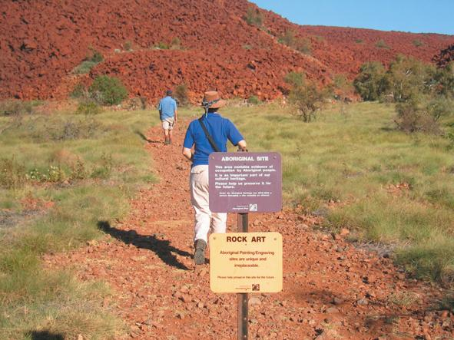
Rock Art Today
Today in Australia, many Aboriginal rock art sites are at risk from permanent damage and need protecting.
Some of these risks come from increased tourism, bushfires, erosion, feral animals, mining, commercial developments, rising rivers, floods and modern graffiti.
As individuals, we can help protect rock art by respecting the wishes of the Aboriginal peoples and following their rules when visiting their sacred rock art sites.
Murujuga National Park
WA Parks and Wildlife Services
Source:
https://parks.dpaw.wa.gov.au/park/murujuga

Slide 10
Rock Art Class Discussion
As a class, discuss some of the reasons why protecting sacred rock art sites across Australia is important to the Aboriginal peoples.
Make a list of ways in which your class could help protect these sites.

Slide 11
Rock Art Activity
Create a rock art mural that tells a story of your class.
Make a ‘rock wall’ by attaching brown paper to a large pin board in the classroom or seek permission from your school principal to paint a small section of an outside wall brown.
Paint, stencil or blow the hands of each class member onto the ‘rock wall’. Ensure that the final ‘picture’ tells a story of the class.
Present the class rock wall mural to your school community. Explain the class story that it represents.

Slide 12
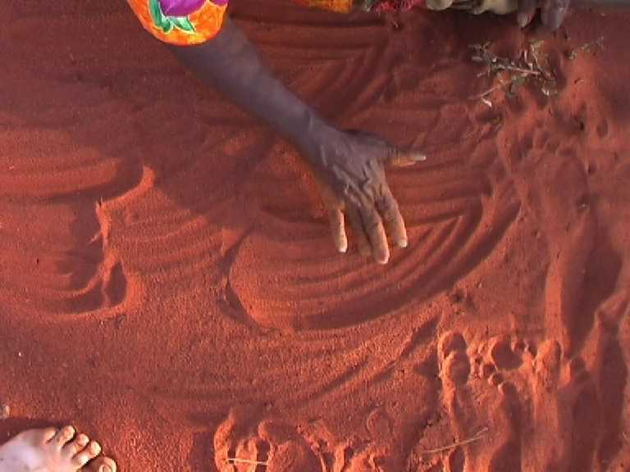
Sand Drawings
Sand drawings are considered a significant ritual in most Aboriginal cultures.
Traditionally, sand drawings were a method used to signify territorial landmarks, tell stories and share the history and origin of the Aboriginal peoples.
Drawing on the sand enables Aboriginal peoples to connect with their great ancestors from the ground and symbolises their own return to the land.
Walmajarri Woman – Sand Talk
The University of Sydney
Source: http://blogs.usyd.edu.au/elac/2006/10/sand_talk_and_how_to_record_it.html

Slide 13
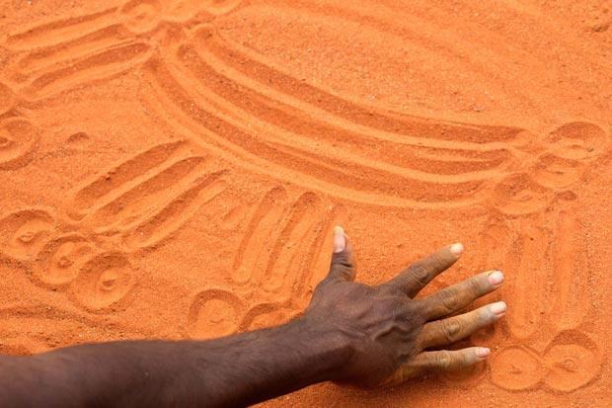
Sand Drawings
Sand drawings are a form of verbal art. An Aboriginal person, most often a leader, will verbally tell a story as they draw symbols and images on the sand with their hand.
Although symbols and their meanings can vary across different language groups, concentric circles are a common symbol used in Aboriginal sand drawings, signifying the creator of the land.
After a story has been told, the drawings are removed by smoothing out the symbols in the sand, concealing significant locations from others.
Reviving Aboriginal Language
David Hancock - Australian Geographic
Source:
http://www.australiangeographic.com.au/topics/history-culture/2013/08/reviving-aboriginal-languages/

Slide 14
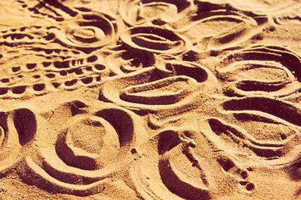
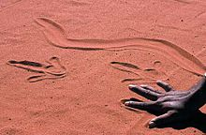
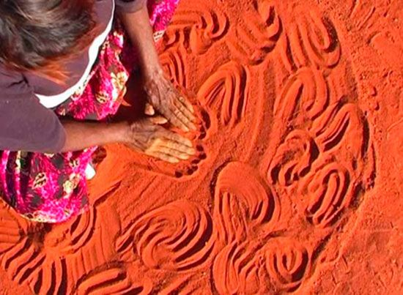
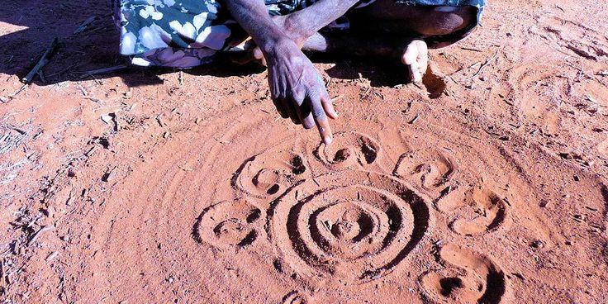
Examples of Sand Drawings
The images below are examples of Aboriginal sand drawings in Australia.
Circles in the Sand, Central Australia.
Sand Painting, Alice Springs.
Eileen Perrwerl, Ti Tree.
Sand Art, Northern Territory.

Slide 15
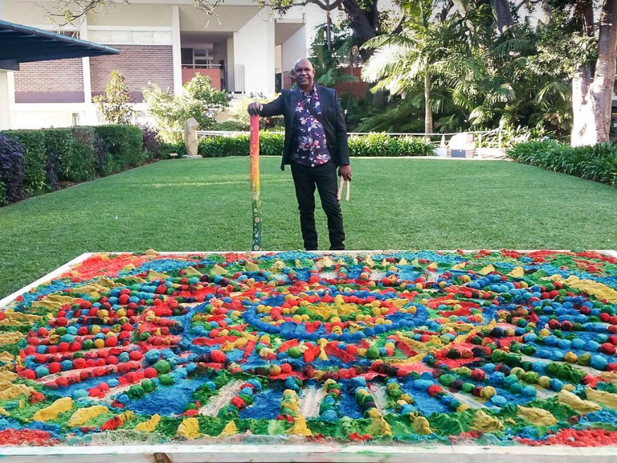
Sand Drawings Today
Sand drawings are still a significant part of Aboriginal culture today.
Colin Walangari Karntawarra McCormack is a contemporary Aboriginal sand artist, creating vibrant images, scaled to the landscape, using coloured sand.
Walangari uses his sand paintings to explain his family’s indigenous culture and beliefs.
“Drawing from our traditions as indigenous Australian desert people, I am able to convey to the audience our knowledge of the cyclic elements of nature and the spirituality of the Dreamtime during the creative process of Aboriginal Sand Panting.” – Walangari
Colin Walangari Karntawarra McCormack
Contempoary Aboriginal Artist
Source:
https://www.walangari.com.au/walangaris-aboriginal-sand-paintings

Slide 16
Sand Drawings Class Discussion
As a class, discuss why Aboriginal peoples traditionally used sand as a way to create maps and share their stories.
Make a list of some of the advantages and disadvantages for using sand as a canvas when drawing maps and telling stories.

Slide 17
Sand Drawings Activity
Create a map of your bedroom using sand drawings.
In small groups, fill a flat tray with sand.
Sitting in a circle, take turns describing your bedroom. As you explain the features of your room, map it out with your hand and fingers in the tray of sand. You may like to create different symbols for different objects in your room.
When you have finished mapping your bedroom, remove your drawings by smoothing the sand over with your hand, then pass the tray of sand onto the next member in the group.
Discuss the different symbols that were used to map each person’s bedroom.

Slide 18
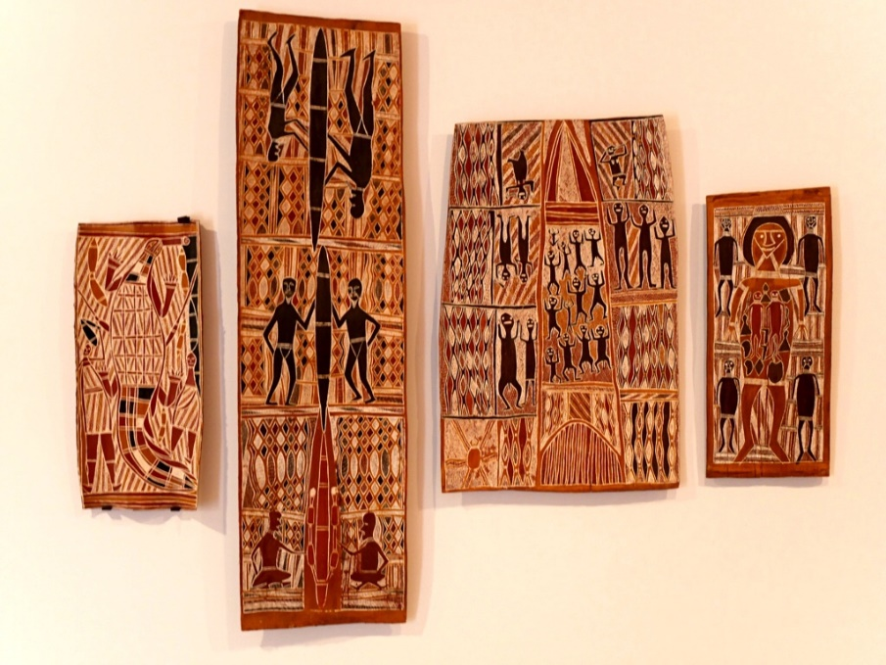
Bark Paintings
Aboriginal bark paintings date back thousands of years.
Originally, the interior part of a tree was used to create paintings, just below a piece of stripped bark.
In preparation for the bark to be used as a canvas, it is now removed from the tree, preferably a eucalyptus tree, cut to size and laid against a fire to dry out.
Dirawong (Goanna) Bark Paintings
Art Gallery NSW
Source:
https://www.artgallery.nsw.gov.au/

Slide 19
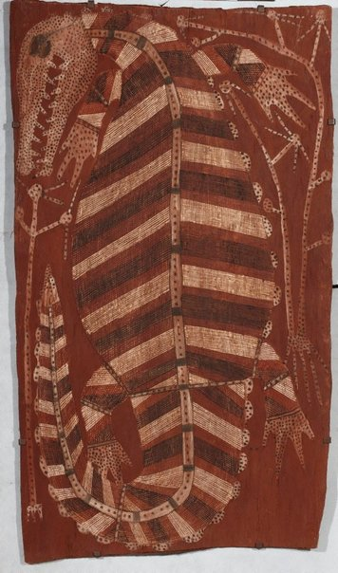
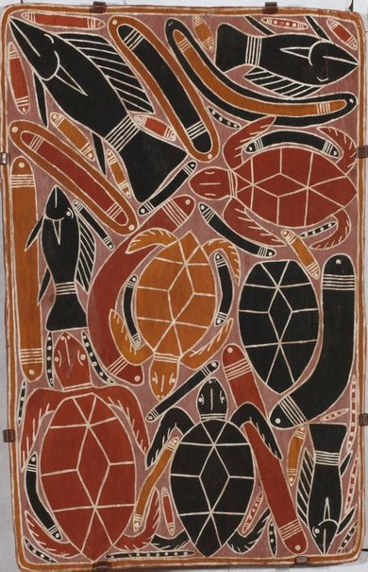
Bark Paintings
Bark paintings show aspects of Aboriginal life.
They enable Aboriginal peoples to share traditional stories and important information, similar to how books are used today.
Bark paintings are also a significant part of most Aboriginal ceremonies, often depicting a group’s totem.
Although different mediums are used to create bark paintings, they mostly consist of earthen colours, such as red, white, black and yellow.
Crocodile - Mick Kubarkku
Art Gallery NSW
Source:
https://www.artgallery.nsw.gov.au/collection/works/393.1987/
Djaranbu ceremony - Jimmy Wululu
Art Gallery NSW
Source:
https://www.artgallery.nsw.gov.au/collection/works/52.1983/

Slide 20
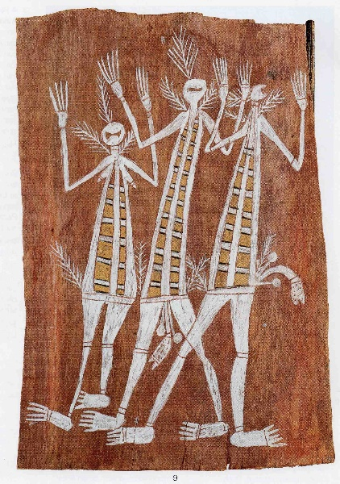
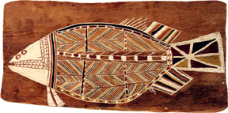
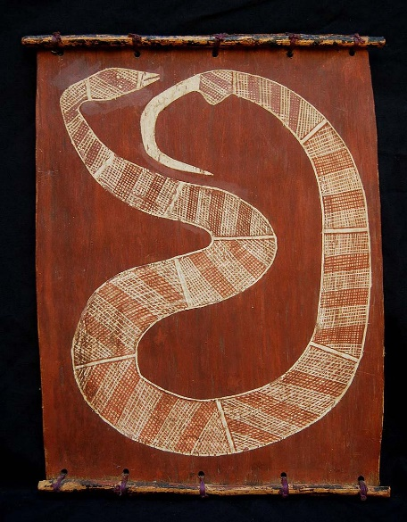
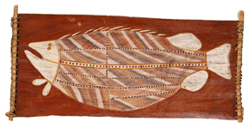
Examples of Bark Paintings
The images below are examples of Aboriginal Bark Paintings from Arnhem Land, Australia.
The Barramundi - Yirawala Namarnkol
Mini Spirits
Snake – Didjbaka Dirdi
Burramundi - John Mawurndjul

Slide 21
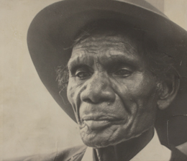
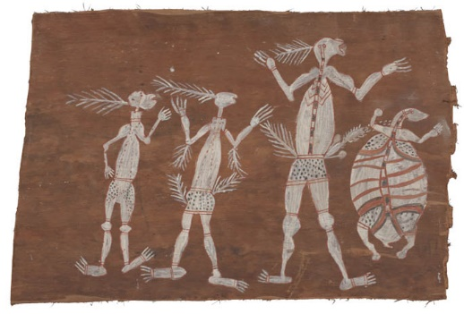
Bark Paintings Today
Bark paintings are still being created today in some areas of Australia, such as Arnhem Land.
Between 1948 and 1988, a group of contemporary Aboriginal artists, known as the ‘Old Masters’, created a range of bark paintings which told stories of their history and cultural rituals. Their artworks were displayed at the National Museum of Australia in Canberra at an expedition during 2013 and 2014.
Today, a variety of contemporary and traditional bark paintings are being conserved in museums and galleries across Australia for the public to respect and appreciate.
Yirawala – Old Masters Artist
National Museum of Australia
Source:
http://www.nma.gov.au/exhibitions/old_masters/artists/yirawala
Mimih and Turtle - Yirawala
National Museum of Australia
Source:
http://www.nma.gov.au/exhibitions/old_masters/artists/yirawala

Slide 22
Bark Paintings Class Discussion
As a class, discuss why Aboriginal peoples traditionally used bark as a way to tell stories of their history and cultural rituals.
Make a list of the benefits for using bark as a canvas when creating art and/or telling a story.

Slide 23
Bark Paintings Activity
Create a pattern on bark to represent your own identity.
Design a pattern that represents your own identity.
Collect a piece of bark or a stick from your school playground or local park.
Paint your pattern onto the bark or stick.
Share your pattern and its meaning with your peers.
As a class, discuss the challenges of painting on bark or sticks.
Create a class display of your bark paintings.

Slide 24
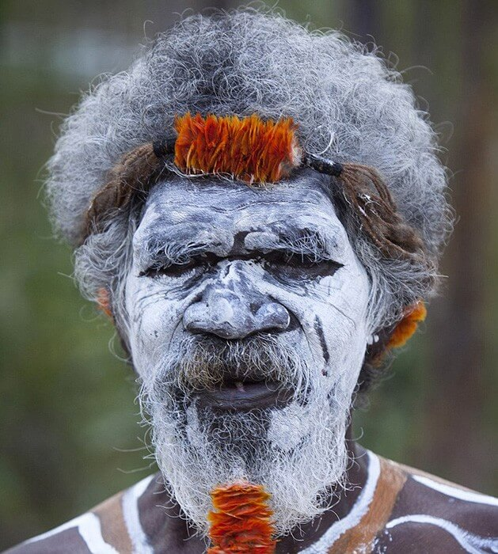
Body Painting
Body painting is an ancient tradition which carries deep spiritual significance for the Aboriginal peoples of Australia.
The designs painted on the body symbolises the relationship Aboriginal peoples have with their family, social position, tribe, ancestors, totem and connection to the land.
Aboriginal body paintings differ across Australia, depending on the Aboriginal group, its topographic and geographic location.
Djunga Djunga Yunupingu – Senior Gumatj Elder
Artlandish
Source:
https://www.aboriginal-art-australia.com/aboriginal-art-library/aboriginal-ceremonial-dancing/

Slide 25
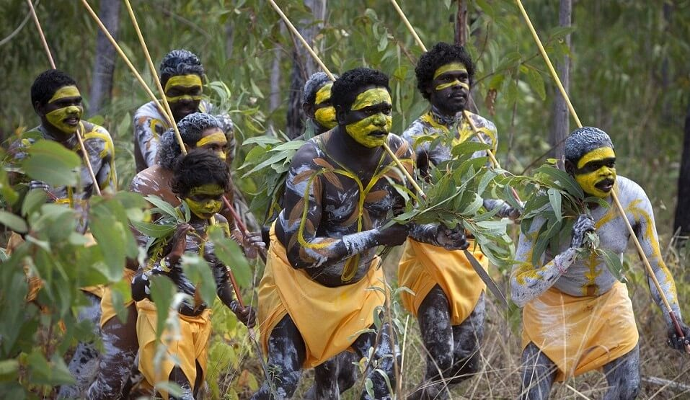
Body Painting
Body painting is often used to tell a story at special Aboriginal ceremonies, along with singing and dancing.
Clay and/or ochre, mixed with animal fat, is used to paint the body. Some ceremonies last for many days so the animal fat helps the paint to stay on the body until the ceremony ends.
Colours such as white, yellow, pink and red are commonly used to paint the body. A person cannot apply their own paint to their own body, another group member must always apply it.
Men in traditional Indigenous body paint
Artlandish
Source:
https://www.aboriginal-art-australia.com/aboriginal-art-library/aboriginal-body-painting-art/

Slide 26
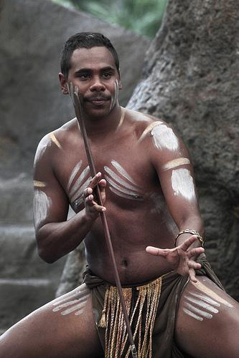
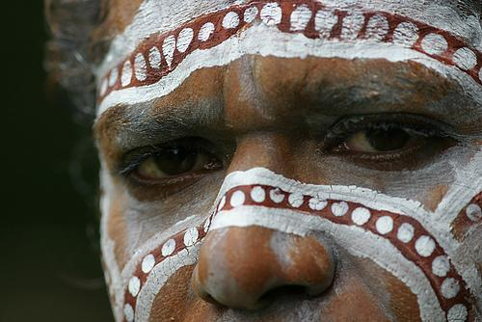
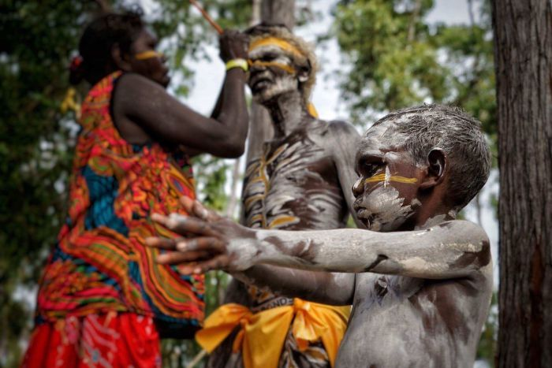
Body Painting Examples
The images below are examples of different Aboriginal Body Paintings.

Slide 27
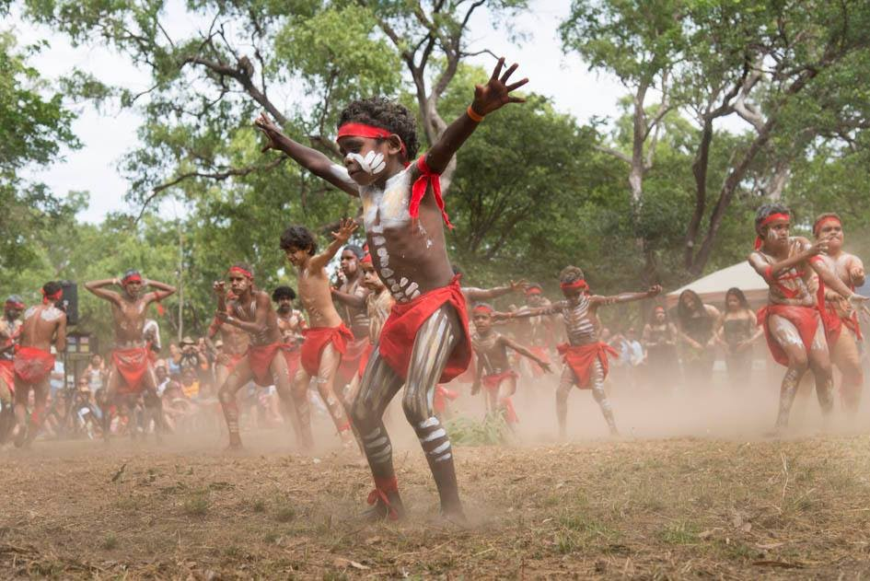
Body Painting Today
Aboriginal peoples still use body painting for special ceremonies today.
Some examples of these ceremonies in Australia where traditional Aboriginal body paintings can be seen include:
Laura Dance Festival, Cape York
Garma, Arnhem Land
Grand Final Day, Tiwi Islands
Tjungu Festival, Uluru
Barunga Festival, Katherine.
Laura Dance Festival
Cape York
Source:
http://www.cairnsevents.com/cape-york-laura-aboriginal-dance-festival-2017.687/

Slide 28
Body Painting Class Discussion
As a class, discuss why Aboriginal peoples traditionally painted their bodies for cultural ceremonies.
Make a list of special occasions or times when you might get your face or body painted.

Slide 29
Body Painting Activity
Create a body paint design to wear at a special event.
Using a template of the outline of a body, draw a design that you would paint onto your body for a special event.
Share your design with a peer and explain which event you would wear it to and why.
As a class, discuss the significance of cultural dress at a special event or ceremony.
Create a class display of your body painting designs.
Notes:
20/06/18- 4J

Slide 30
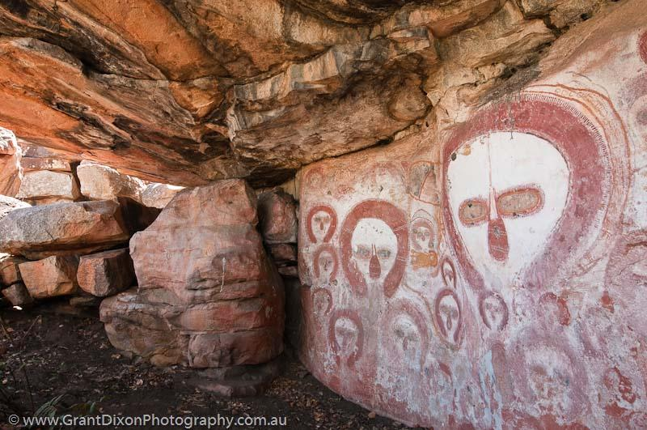
Wandjina Artworks
4000 years worth of Wandjina artworks can be seen in caves and on rocks across the Kimberley region in Western Australia.
These Wandjina figures are a creator and protector to the Aboriginal peoples of the Kimberley area.
The Aboriginal peoples consider Wandjina paintings to be cloud rain spirits, ensuring that it will rain every year after each dry season.
Wandjina – Creator Beings
Bachsten Creek, West Kimberly WA
Source:
http://www.grantdixonphotography.com.au/galleries/image.php?id=2093&gid=26

Slide 31
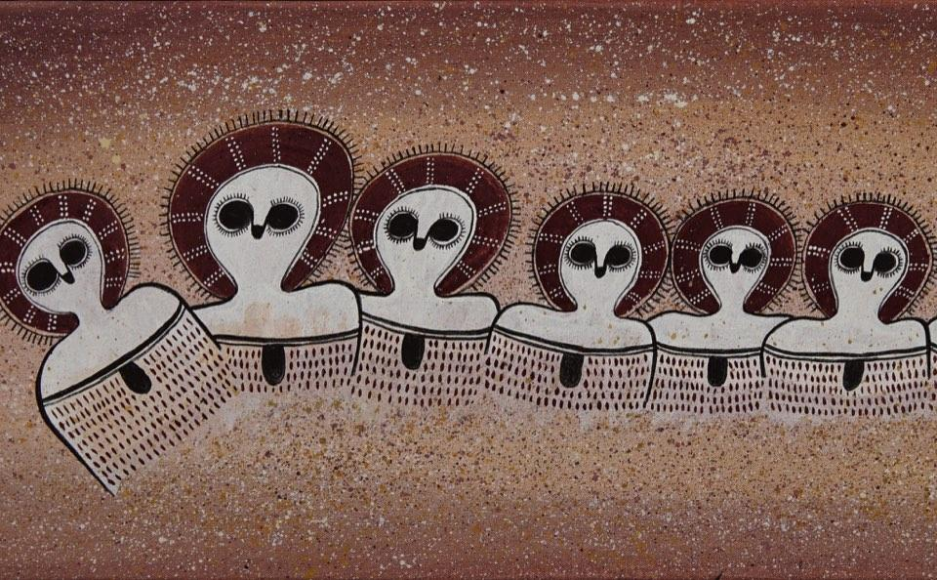
Wandjina Artworks
Only three Aboriginal groups within the Kimberley have permission to paint Wandjina artworks.
Two different types of figures are commonly painted, depending on the water source. One figure is used for fresh water whilst another is used for salt water.
Aboriginal peoples have a great spiritual connection with the Wandjina figures, at times referring to them as ‘gods of falling water’.
Wandjinas
Mowanjum People
Source:
https://japingkaaboriginalart.com/wandjinas-ochre-and-the-art-of-mowanjum-people/

Slide 32
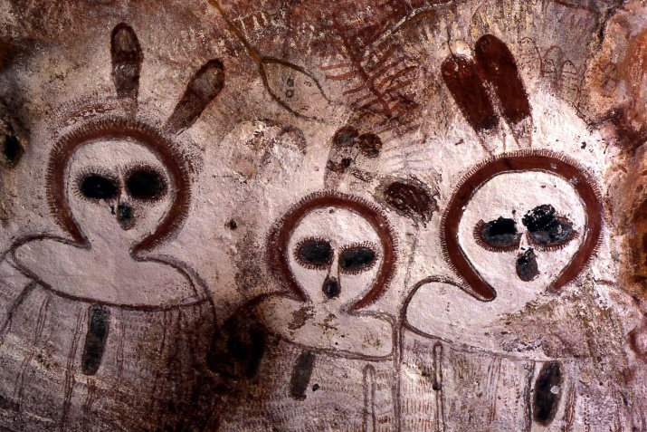
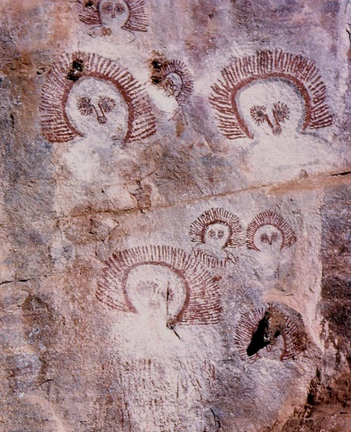
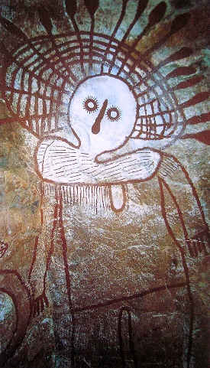
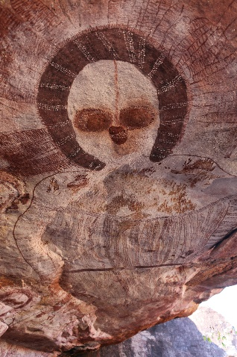
Wandjina Artworks Examples
The images below are examples of different Aboriginal Wandjina artworks found in the Kimberley area of Western Australia.
Wandjina Cave Painting – Mount Barnett, Western Australia
Wandjina Faces – Saddlers Springs, Western Australia
Namarali – Karndirrim Rock
Cloud and Rain Spirit – The Kimberley, WA

Slide 33
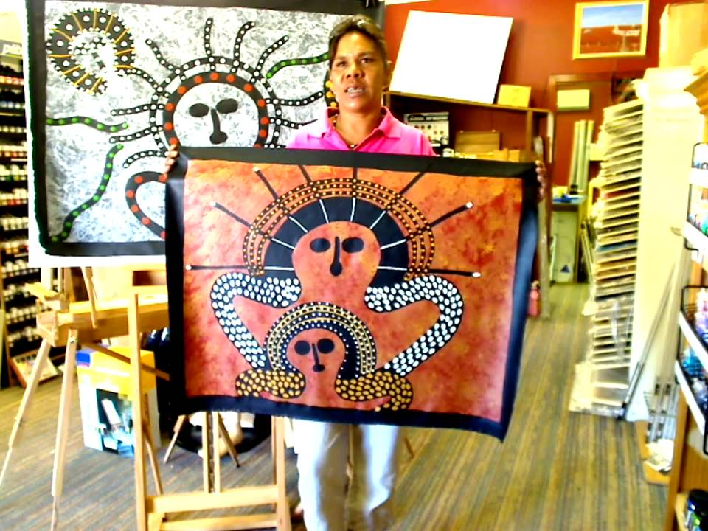
Wandjina Artworks Today
Original Wandjina artworks can still be seen in the Kimberley area of Western Australia.
In the Kimberley, tours of Wandjina paintings are run by local Aboriginal rangers to help educate Aboriginal and non-Aboriginal peoples about the history of the Wandjina spirits, ensuring that the artworks are respected and preserved.
Julie Wungundin is an Aboriginal artist from the Kimberley town of Derby in Western Australia. Today she has permission from her community to create a range of contemporary Wandjina artworks.
Julie Wungundin - Wandjina Artist

Slide 34
Wandjina Artworks Class Discussion
As a class, discuss why the Aboriginal peoples traditionally referred to the Wandjina artworks as ‘gods of falling water’.
Make a list of other ancient cultures that might have had gods relating to natural phenomenon. For example, the ancient Egyptians had a god for the sun.

Slide 35
Wandjina Artworks Activity
Create a silhouette artwork of a ‘god’ for a natural phenomenon.
Think of a natural phenomenon that you appreciate. For example, the sun, the moon, snow, rainbows, rivers, clouds, etc.
In your mind, picture a ‘god’ for creating this phenomenon.
Create an artwork of a silhouette for your imaginary ‘god’.
Share your artwork with a peer and explain what your ‘god’ represents.
Make a class display of the silhouette artworks.

Slide 36
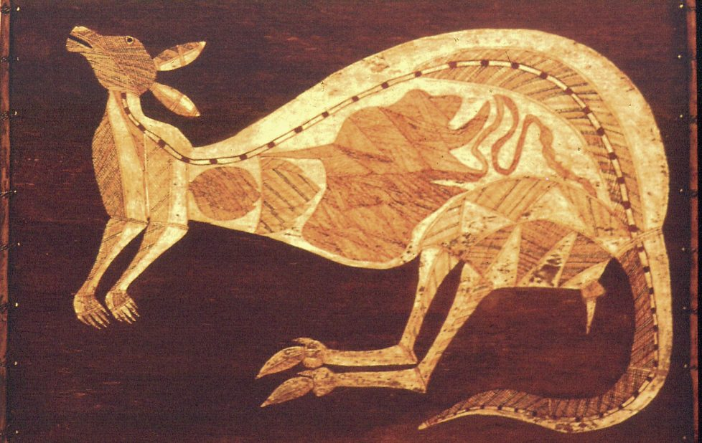
X-Ray Art
X-Ray art is a traditional style used by the Aboriginal peoples of Australia to depict native animals and to share cultural stories.
The anatomical features of the animals seen in x-ray art are painted to show what the animal looks like inside, illustrating bone structures and organs.
This style of x-ray painting helps to create a three-dimensional effect of the animal.
Kunwinjku Djukerre
Dick Nguleingulei
Source:
http://www.aboriginal-art.de/EN/kunstformen_rindenmalerei.htm

Slide 37
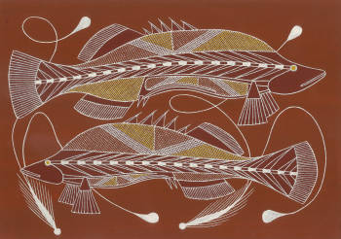
X-Ray Art
Aboriginal x-ray art is mostly evident in the areas around Arnhem Land in the Northern Territory.
X-ray art enables an artist to express their connection and understanding of country and their relationship with local fauna.
Most Aboriginal x-ray artists will paint native animals found in the area where they live and/or of their totem.
Two Barramundi Swimming in the Billabong
Leslie Nawirridj
Source:
http://www.kunwinjku-aboriginal-art.com/aboriginal-art-prints.html

Slide 38
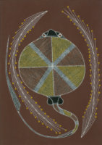
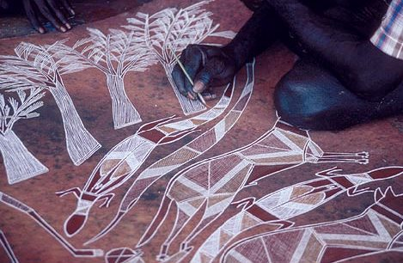
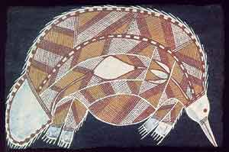
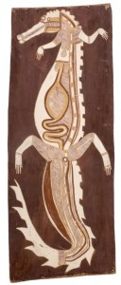
X-Ray Art Examples
The images below are examples of different Aboriginal x-ray art.
Stingray
Goannas
Echidna
Crocodile

Slide 39
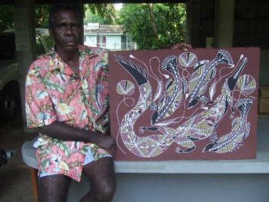
X-Ray Art Today
Leslie Nawirridj is a well-known contemporary Aboriginal x-ray artist in Darwin and a senior member of the Kunwinjku artist group.
Leslie’s artworks use traditional techniques, passed on from his ancestors. He uses his paintings as a way to display his knowledge and understanding of his Aboriginal heritage.
Today, Leslie can be seen selling his x-ray artworks at the Darwin Parap Village Saturday Markets.
Leslie Nawirridj
Contemporary Aboriginal X-Ray Artist
Source:
http://www.kunwinjku-aboriginal-art.com/aboriginal-art-online.html

Slide 40
X-Ray Art Class Discussion
As a class, discuss reasons why traditionally, it might have been important for Aboriginal peoples to paint the anatomical features of animals in their x-ray art.
Make a list of native Australian animals that could be painted in the x-ray style.

Slide 41
X-Ray Art Activity
Create an x-ray artwork of a native Australian animal.
Choose a native Australian animal using the class list (brainstormed from the previous slide).
Draw an outline of your native animal, then using your own knowledge of the animal, and your interpretation of Aboriginal x-ray art, create an x-ray artwork of your chosen native Australian animal.
Share your x-ray art with a peer and explain your animal, the bone structures and/or organs you have included.
Make a display of the class’ x-ray art.

Slide 42
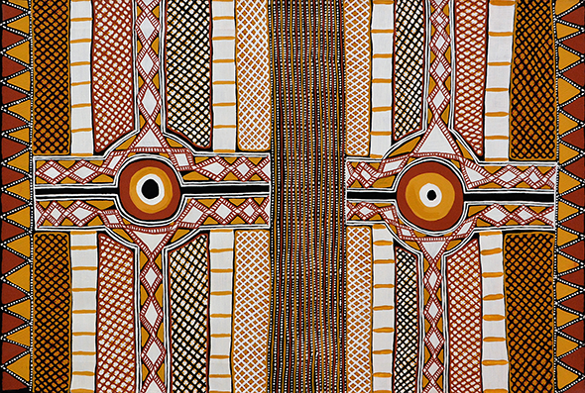
Cross-Hatching
Cross-hatching is a common Aboriginal style of art, prominently seen in the Northern parts of Australia around Arnhem Land.
Some Aboriginal peoples believe that cross-hatching artworks hold great spiritual powers.
Cross-hatching, also known as Rarrk, is a unique feature of Kunwinjku Aboriginal art. The fine strokes seen in Rarrk were originally painted with ochre using grass, reeds or human hair. Today the fine strokes are painted with brushes.
Rarrk
Cross Hatching Artworks
Source:
https://www.kateowengallery.com/page/Cross-Hatching-Painting-Rarrk.aspx

Slide 43
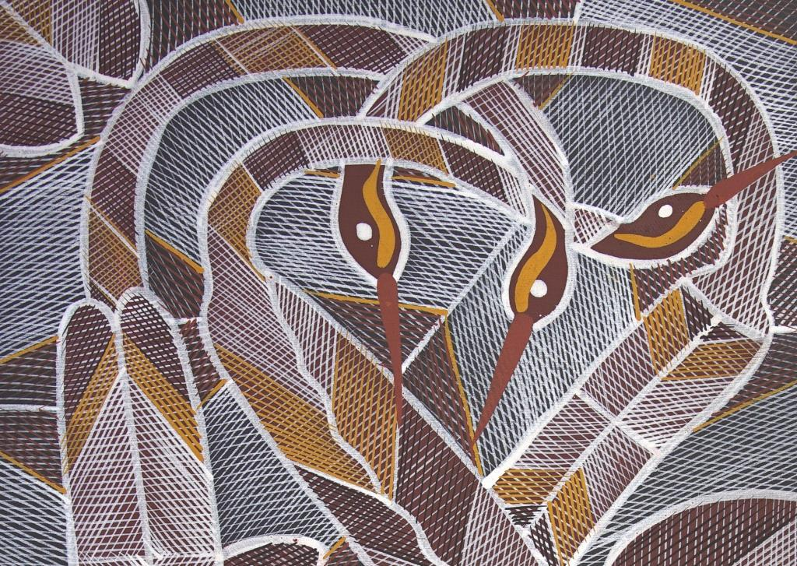
Cross-Hatching
Rarrk artworks are referred to as cross-hatching because of the technique of many parallel lines crossing over.
A typical large painting can take an artist up to one year to complete.
Originally created as traditional ceremonial paintings, most cross-hatching artworks represent native animals such as sea creatures, marsupials and reptiles.
Edward Blitner – Cross-Hatching Artworks
Roper River, Arnhem Land
Source:
https://japingkaaboriginalart.com/edward-blitner-new-works-rarrk-cross-hatching/

Slide 44
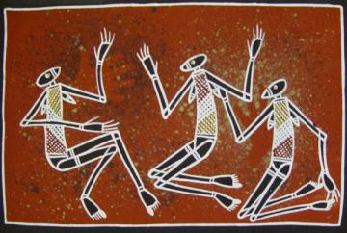
Cross-Hatching Examples
The images below are examples of Aboriginal Rarrk artworks using cross-hatching.
Bianca Sprat – Mimi Women
Warrnyn – Flying Foxes
Crow and Widitj
Edward Blitner - Mimi Rock Spirits

Slide 45
Cross-Hatching Today
Cross-hatching is still used in Aboriginal art today.
John Mawurndjul is a contemporary Aboriginal artist from the Northern Terrirotry who is known for his collection of Rarrk paintings.
He also created an art school and was responsible for leading an exciting contemporary art movement in Australia.
In 2000, John’s works were featured at the Sydney Biennale. In 1999, 2002 and 2016 he won the bark painting prize at the Telstra National Aboriginal and Torres Strait Islander Art Awards.
John Mawurndjul – Contemporary Cross-Hatching Artist
Kurulk Clan - Maningrida, Northern Territory
Source:
https://maningrida.com/artist/john-mawurndjul/

Slide 46
Cross-Hatching Class Discussion
As a class, discuss why it may take an Aboriginal artist a whole year to complete a large cross-hatching painting.
Make a list of the techniques and colours used in a traditional cross-hatching painting. Use one of the artworks from the previous slides to help you.

Slide 47
Cross-Hatching Activity
Create a cross-hatching artwork of your hand.
Trace the outline of your hand.
Use cross-hatching techniques to fill the space of your hand.
Share your cross-hatching design with a peer and explain what the designs inside your hand mean to you.
Make a class hand display of the cross-hatching artworks.

Slide 48
Dot Painting
Compared to other traditional Aboriginal painting techniques, dot painting is considered a contemporary style of Aboriginal art.
In 1971, Geoffrey Bardon, an art teacher working near Alice Springs, asked his students to paint a mural on the school wall that represented The Dreaming.
The result was a wall of abstract design. The students chose to use dots to conceal the sacred meanings of their dreaming stories.
Geffrey Bardon – Art Teacher
First Aboriginal Dot Painting - Papunya
Source:
https://www.creativespirits.info/aboriginalculture/arts/are-dot-paintings-traditional-aboriginal-art

Slide 49
Dot Painting
Dot paintings have become a visual representation of Aboriginal peoples identities.
In some Aboriginal cultures, it has enabled Aboriginal peoples to transfer their sand drawings onto canvas.
Originally, colours produced from ochre, charcoal and pipe clay were restricted to variations of red, yellow, black and white. Later, acrylic mediums were introduced for more vivid colourful dot paintings.
Bush Fire
Gabriella Possum Nungurrayi
Source:
https://teachik.com/aboriginal-art/

Slide 50
Dot Painting Examples
The images below are examples of Aboriginal dot paintings.

Slide 51
Dot Painting Today
Maureen Hudson Nampijinpa is a Walpiri artist and is known in Australia for her modern Aboriginal fine dot paintings.
Her artworks are a beautiful blend of traditional and contemporary design. Maureen’s dot techniques give her paintings a 3D effect and a sense of movement and rhythm.
Most of Maureen’s artworks are aerial view maps of sandhills and underground waterholes from her country.
Contemporary Dot Painting Artist
Maureen Hudson Nampijinpa
Source:
https://japingkaaboriginalart.com/remarkable-contemporary-aboriginal-fine-dot-painting/

Slide 52
Dot Painting Class Discussion
As a class, discuss reasons why the students at Geoffrey Bardon’s school might have used dots to conceal the sacred meaning of The Dreaming.
Make a list of the techniques and colours used in Aboriginal dot painting. Use the artworks from the previous slides to help you.

Slide 53
Dot Painting Activity
Create a dot painting artwork of your foot.
Trace the outline of your foot.
Use dot painting techniques to fill the space of your foot.
Share your dot painting design with a peer and explain what the dots inside your foot mean to you.
Make a class foot display of the dot painting artworks under the heading “We Walk Together as One”.

Slide 54
Teacher Notes
References
The following list of websites have been used as references for this PowerPoint Presentation.
https://www.aboriginal-art-australia.com/aboriginal-art-library/aboriginal-art-styles/
https://www.creativespirits.info/aboriginalculture/arts/aboriginal-rock-art#ixzz4zCp3rsYD
http://www.indigenousinstyle.com.au/aboriginal-art-history/aboriginal-sand-art/
https://www.walangari.com.au/walangaris-aboriginal-sand-paintings
http://www.indigenousinstyle.com.au/aboriginal-art-history/aboriginal-bark-painting/
http://www.indigenousinstyle.com.au/aboriginal-art-history/aboriginal-body-art/
https://www.aboriginal-art-australia.com/aboriginal-art-library/aboriginal-body-painting-art/
http://www.indigenousinstyle.com.au/aboriginal-art-symbols/aboriginal-body-art-symbols/
https://www.abccommercial.com/contentsales/program/kimberley-land-wandjina
http://www.kunwinjku-aboriginal-art.com/aboriginal-x-ray.html
http://www.personally-selected-aboriginal-art.com/rarrk.html
https://maningrida.com/artist/john-mawurndjul/
https://www.aboriginal-art-australia.com/aboriginal-art-library/aboriginal-dot-art-behind-the-dots/
https://japingkaaboriginalart.com/remarkable-contemporary-aboriginal-fine-dot-painting/

